Slide 1
Leveraging Technology to Improve Customer Experience while signing for Insurance
CSE7301 Capstone Project
Review-0
Batch Number:
Roll Number | Student Name
20211CSE0674 | Rohit S M
20211CSE0631 | Prashanth S N
20211CSE0666 | Nithin H M
20211CSE0671 | Dhanush C R
20211CSE0889 | Kanala Krishna
Under the Supervision of,
Mr. Syed Mohsin
School of Computer Science and Engineering
Presidency University
Name of the Program: CSE
Name of the HoD: Dr. Asif Mohammed H.B
Name of the Program Project Coordinator: Mr. Syed Mohsin
Name of the School Project Coordinators: Dr. Sampath A K / Dr. Abdul Khadar A / Mr. Md Ziaur Rahman

Slide 2
Content
Problem Statement
Github Link
Analysis of Problem Statement
Timeline of the Project
References

Slide 3
Problem Statement Number: PSCS_353
Organization: Future Generali
Category (Hardware / Software / Both) : Software
Problem Description:
Manual ticket booking results in long wait times, especially during weekends or special events, frustrating visitors. Staff may make mistakes like issuing wrong tickets, double-booking, or misplacing records, causing operational issues. Manual systems do not support 24/7 access or multilingual support, limiting access for diverse and remote users. Manual systems fail to collect useful visitor data that could help in making informed business decisions. The outdated process reduces overall satisfaction, discouraging repeat visits and damaging the museum’s reputation. Difficulty Level : Complex

Slide 4
Problem Statement Number: PSCS_353
Organization: Future Generali
Category (Hardware / Software / Both) : Software
Problem Description:
Manual ticket booking results in long wait times, especially during weekends or special events, frustrating visitors.
Staff may make mistakes like issuing wrong tickets, double-booking, or misplacing records, causing operational issues.
Manual systems do not support 24/7 access or multilingual support, limiting access for diverse and remote users.
Manual systems fail to collect useful visitor data that could help in making informed business decisions.
The outdated process reduces overall satisfaction, discouraging repeat visits and damaging the museum’s reputation.

Slide 5
Github Link
The Github link provided should have public access permission.
Github Link
https://github.com/Prashanth0718/ONLINE-CHATBOT-TICKETING-SYSTEM

Slide 6
Analysis of Problem Statement
Technology Stack Components: Software – Web App Development
1. Front-End (User Interface)
React.js: For building responsive and dynamic user interfaces.
Tailwind CSS: For modern, utility-first styling.
Axios: For making HTTP requests to the backend.
React Router: For seamless navigation between pages.
Framer Motion: For adding smooth animations to UI elements.
2. Back-End (API & Server)
Node.js: JavaScript runtime for building scalable server-side applications.
Express.js – Lightweight web framework for routing and middleware
JWT & Bcrypt: For authentication and secure password management
MongoDB : For storing and handling multiple data.

Slide 7
Analysis of Problem Statement (contd...)
3. Libraries and APIs
Razorpay API: For secure payment and refund integration.
Nodemailer: For sending OTPs and password reset emails.
I18next: For multilingual support in the chatbot.
Gemini API: For responses
4. Development Tools
Visual Studio Code (VS Code): Code editor with great extensions for web development.
Postman: For testing API endpoints.
Git: Version control for tracking changes in codebase.
5. Deployment Tools
Netlify – Hosting platform for deploying the React frontend.
Render – Cloud service for deploying Node.js backend.
MongoDB Atlas – Cloud-hosted MongoDB database.
GitHub Actions – For continuous integration and deployment (CI/CD).

Slide 8
Analysis of Problem Statement (contd...)
Software Requirements:
1. Operating System
Windows, macOS, or Linux: Any modern OS capable of running development environments.
2. Development Environment
Code Editor : Visual Studio Code
Node.js: For back-end development and running JavaScript on the server-side.
Database Management Tool : MongoDB.
3. Version Control
Git: For managing version control and collaboration.
GitHub : For hosting the repository.

Slide 9
Analysis of Problem Statement (contd...)
Hardware Requirements:
1. Development Machine
Processor: Intel i5 (or equivalent AMD) or higher.
RAM: 8GB or more for handling multiple tasks such as running the local server, browser, and development tools simultaneously.
Storage: 256GB SSD or more for faster performance and to handle development tasks quickly.
2. Internet Connection
Stable broadband connection for accessing APIs, cloud storage, and deploying the application to cloud platforms.

Slide 10
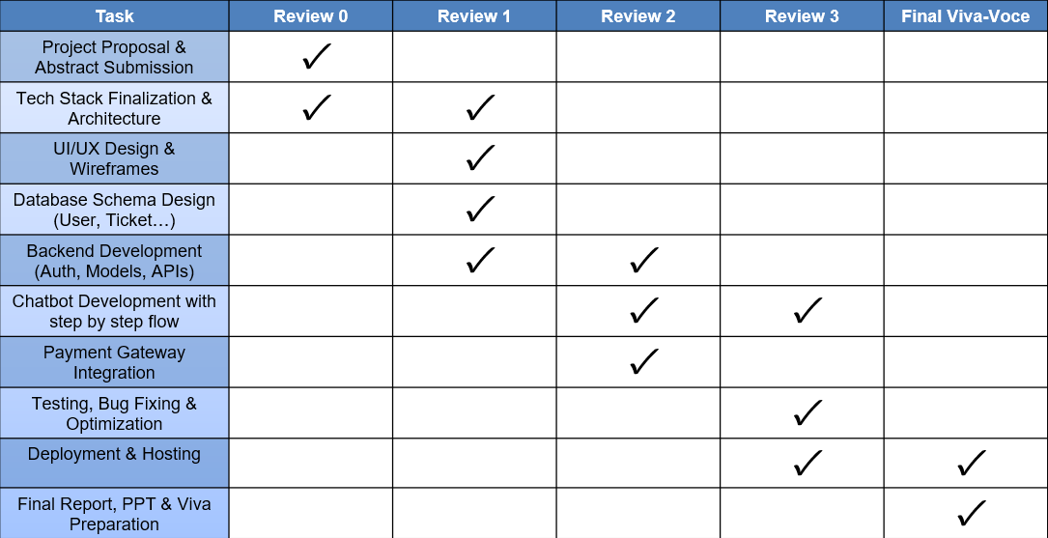
Timeline of the Project (Gantt Chart)

Slide 11
References (IEEE Paper format)
S. J. Russell and P. Norvig, Artificial Intelligence: A Modern Approach, 3rd ed. Pearson Education, 2010.
M. McTear, Z. Callejas, and D. Griol, The Conversational Interface: Talking to Smart Devices, Springer, 2016.
N. Jain and A. Sinha, "Intelligent Chatbot for Smart Ticket Booking Using Artificial Intelligence," International Research Journal of Engineering and Technology (IRJET), vol. 6, no. 3, pp. 1320–1323, Mar. 2019.
M. Salampasis, "e-Ticketing: The smart way of handling public transport ticketing," Journal of Computer and Communications, vol. 3, no. 5, pp. 1–8, 2015. doi:10.4236/jcc.2015.35001.
MongoDB Inc., “MongoDB: The Application Data Platform,” [Online]. Available: https://www.mongodb.com
Razorpay, “Razorpay Payment Gateway Documentation,” [Online]. Available: https://razorpay.com/docs/
ReactJS, “React – A JavaScript library for building user interfaces,” [Online]. Available: https://reactjs.org

Slide 12


